Slide 1

Sector: Education & Financial Inclusion
Sub-system: Digital Literacy and Personal Finance
PROJECT TITLE:
Digital Literacy and Financial Management
TEAM DETAILS
24EG107H21-Spandana
24EG107H28-Shruti
24EG107H36-Sai Varshini
24EG107H62-G Bhavana
24EG107H65-Mohammad Abrar Ansar
UNDER THE GUIDANCE OF: CHAMUNDESHWARI AND NEETHA

Slide 2
AGENDA
      Ambitious “How Might We…”
      Problem Statement
      Severity of the Problem
      Stakeholder Identification
      Root Cause Analysis
      Conflicting Stakeholder Priorities
      Ideation
      Idea Proposal
      Prototype Design
      Implementation Challenges
      Scope of Improvement
2
PSE | Digital Literacy & Financial Management

Slide 3
OUR VISION
A community where every person can confidently use digital services and make informed financial decisions.
HOW MIGHT WE…
• How might we teach people to use smartphones, the internet and online services safely?
• How might we help users plan budgets, track spending and build savings habits?
• How might we make digital payments safer and easier for first-time users?
• How might we deliver learning in simple language, with practical examples?
IDEAL OUTCOME
Learn → Practice safely → Manage money → Make confident decisions
3
PSE | Digital Literacy & Financial Management

Slide 4
PROBLEM STATEMENT
Many people have limited confidence in using digital tools and managing everyday finances. This can make online services, digital payments, budgeting and saving difficult or risky.
SEVERITY OF THE PROBLEM
High impact on independence and inclusion. Possible outcomes include payment mistakes, exposure to scams, poor budgeting and dependence on others. Severity varies by user and context.
KEY STAKEHOLDERS
• Primary users: students, first-time smartphone users, low-confidence digital users, families
• Supporters: teachers, community volunteers, financial-literacy trainers
• Enablers: banks, payment providers, government and public-service organisations
4
PSE | Digital Literacy & Financial Management

Slide 5
ROOT CAUSE ANALYSIS
Limited hands-on training
↓
Fear of making mistakes or being scammed
↓
Low confidence with apps and online services
Other contributing causes:
• Complex interfaces and unfamiliar terms
• Limited access to reliable devices/connectivity
• Financial concepts taught without practical budgeting
• Lack of trusted, local-language learning resources
CONFLICTING STAKEHOLDER PRIORITIES
Users: simplicity, privacy and confidence
Banks / payment providers: secure transactions and fraud prevention
Educators: learning outcomes and easy assessment
Families: safety and support
Developers: affordability, accessibility and maintainability
Design response: simple interface, privacy-first demo data, clear warnings, accessible lessons and practical exercises.
PSE | Digital Literacy & Financial Management
5

Slide 6
WHY THIS MATTERS
Digital skills and financial capability affect access to education, services, safe payments and day-to-day money decisions.
EVIDENCE TO INCLUDE
• Household / community survey on digital confidence
• Short pre-test on budgeting and scam awareness
• Prototype usability test: task completion and errors
• Feedback from students, families or community users
MEASURABLE INDICATORS
• Quiz score before vs. after learning
• Budgeting task completion rate
• Correct identification of scam warning signs
• User confidence rating and satisfaction
PSE | Digital Literacy & Financial Management
6

Slide 7
IDEATION — POSSIBLE IMPROVEMENTS
• Short lessons on smartphone basics, internet search and online forms
• Digital-payment safety checklist and scam-awareness examples
• Simple monthly budget planner: income, needs, wants and savings
• Expense tracker with categories and weekly summaries
• Goal-based savings calculator
• Quizzes, badges and progress tracking
• Local-language content and large, readable controls
• Offline printable guides and facilitator-led demonstrations
SELECTION CRITERIA
Impact • Ease of use • Cost • Accessibility • Privacy • Feasibility
PSE | Digital Literacy & Financial Management
7

Slide 8
PROPOSED PROTOTYPE
A simple web-based learning and money-management companion.
Module 1 — Digital Literacy
• Device and internet basics
• Safe browsing, passwords and scam awareness
• Digital payment safety
Module 2 — Financial Management
• Monthly budget planner
• Expense tracking
• Savings goal calculator
EXPECTED BENEFITS
• Learn at the user's own pace
• Practice with sample data before real transactions
• Understand spending patterns
• Build regular saving habits
• Improve awareness of online risks
• Provide a low-cost resource for workshops
Prototype boundary: educational tool only; it does not connect to bank accounts or execute payments.
PSE | Digital Literacy & Financial Management
8

Slide 9
USER → HOME DASHBOARD → CHOOSE A MODULE → LEARN / ENTER SAMPLE DATA → FEEDBACK & PROGRESS
USER INTERFACE
Home dashboard
Lessons and quizzes
Budget / expense forms
Progress summary
APPLICATION LOGIC
Validate inputs
Calculate totals
Categorise expenses
Score quiz responses
DATA & OUTPUT
Sample/local data
Learning progress
Budget summary
Safety tips and feedback
Suggested prototype stack: HTML, CSS and JavaScript; optional Flask backend if persistence is required.
PSE | Digital Literacy & Financial Management
9

Slide 10
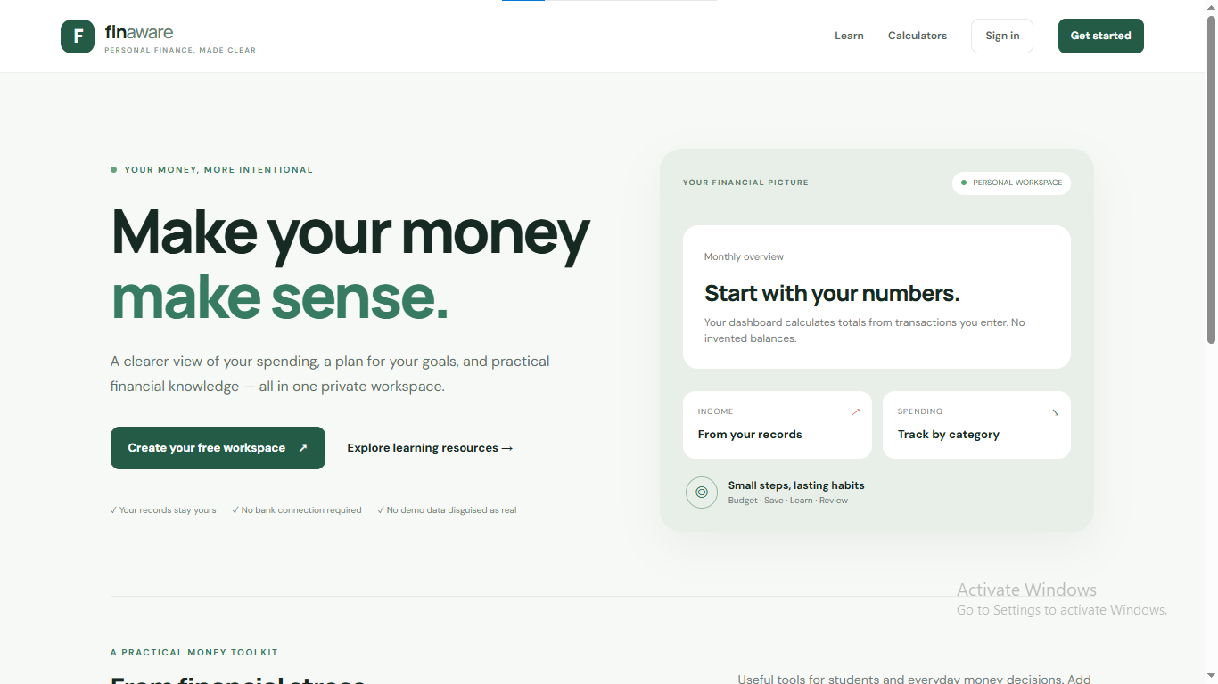
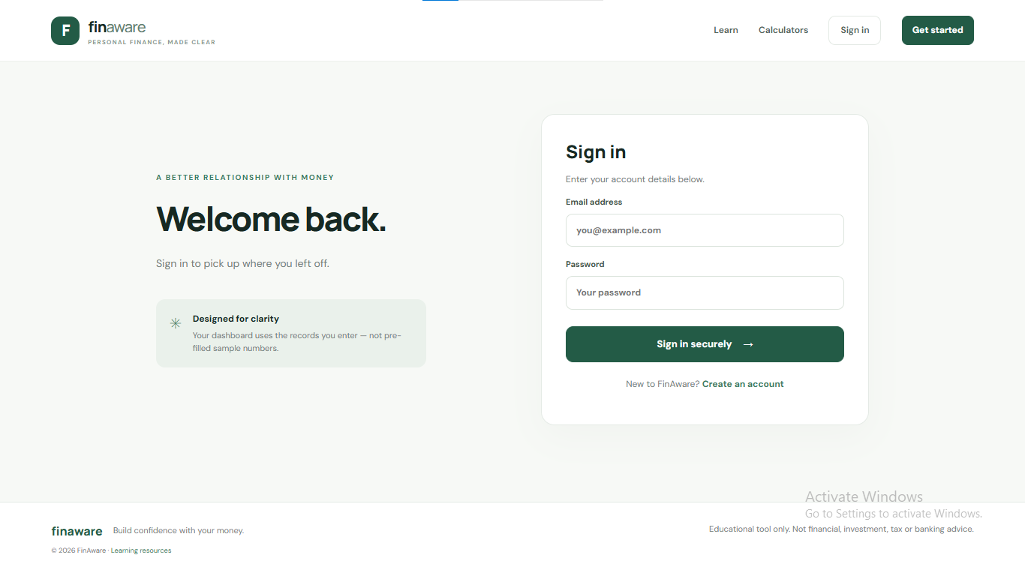
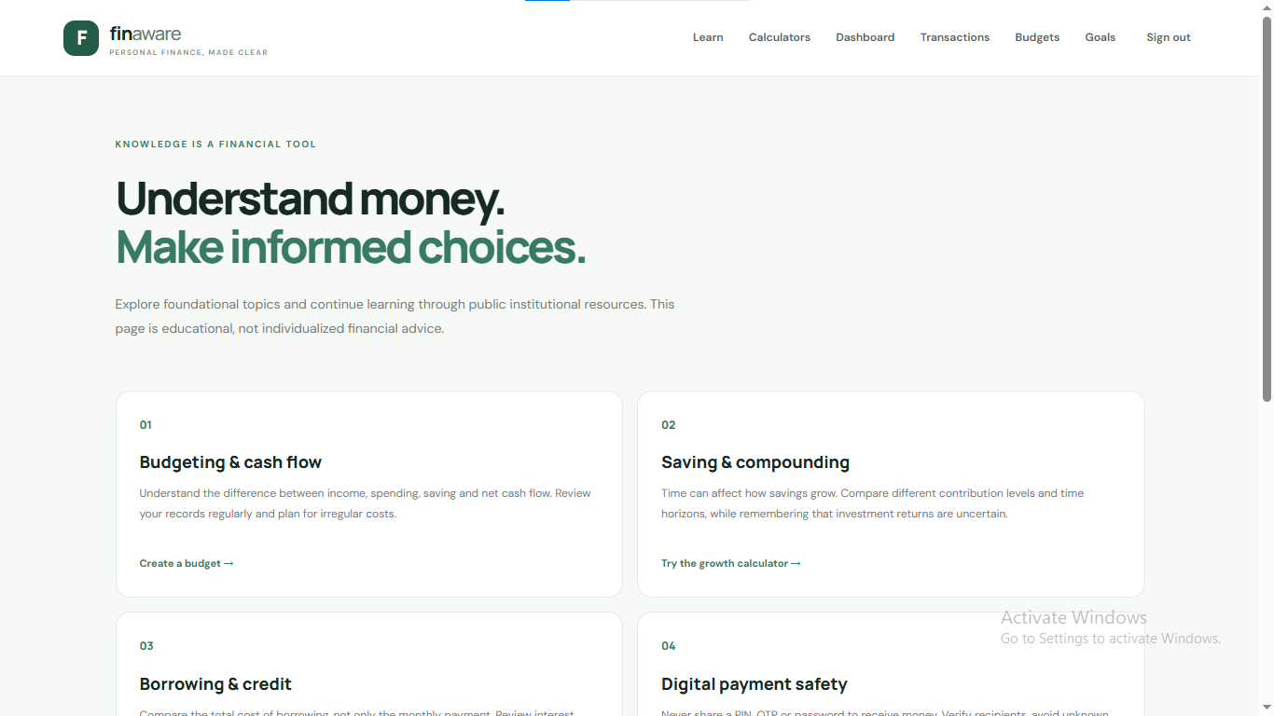
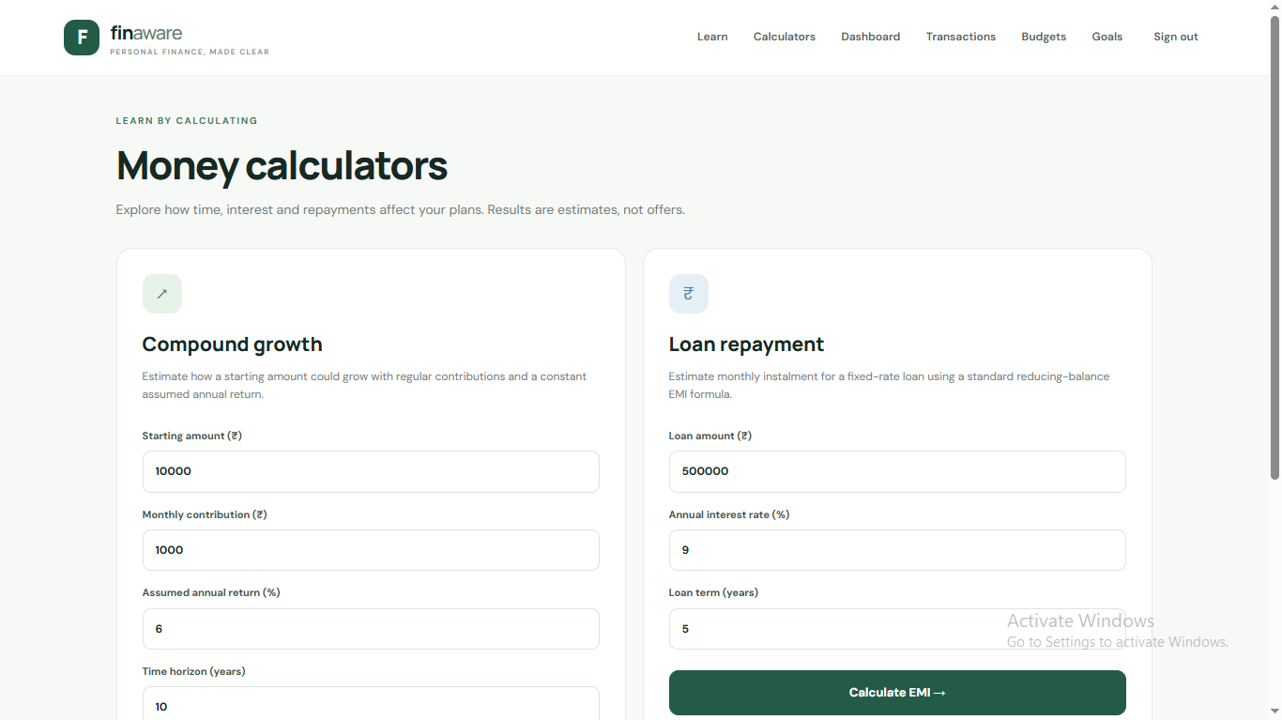
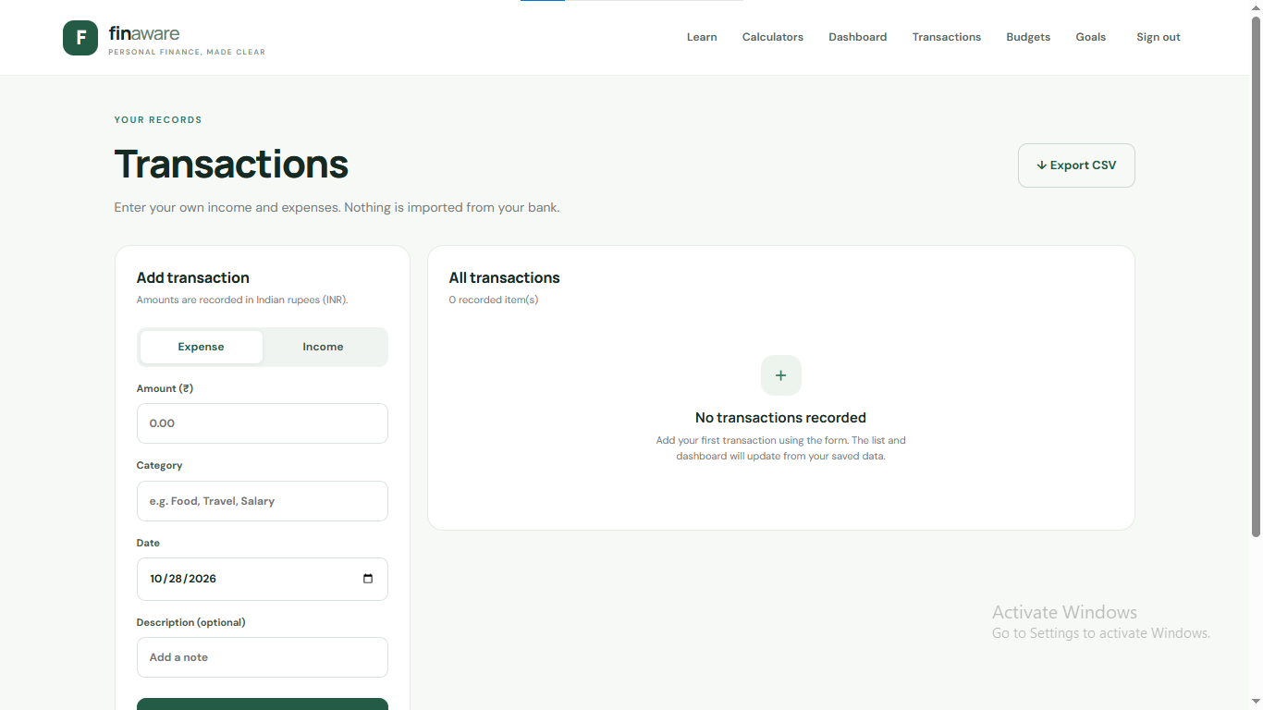
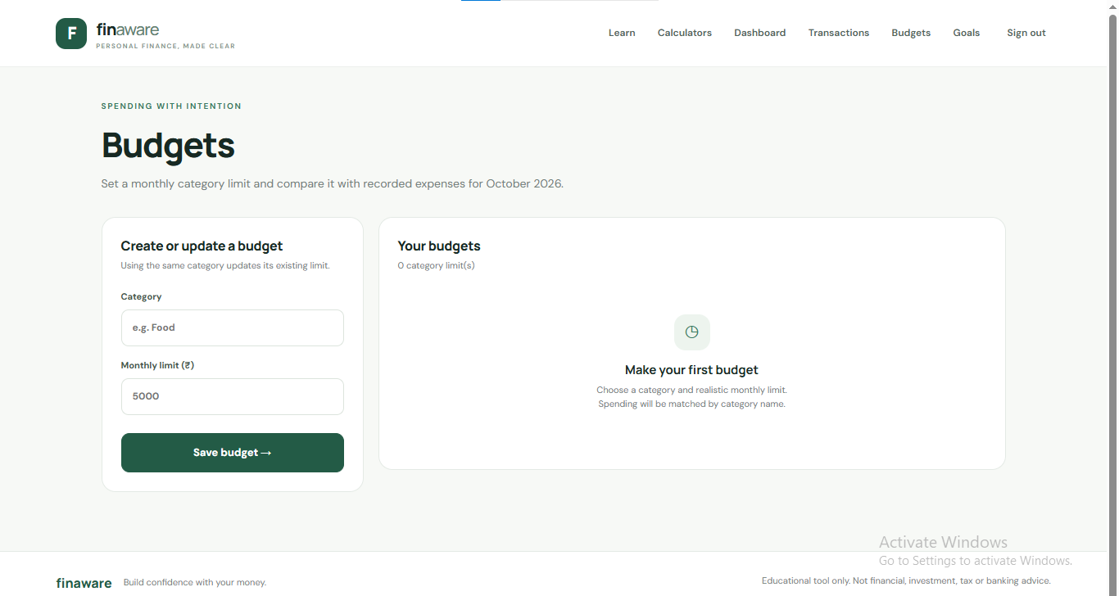
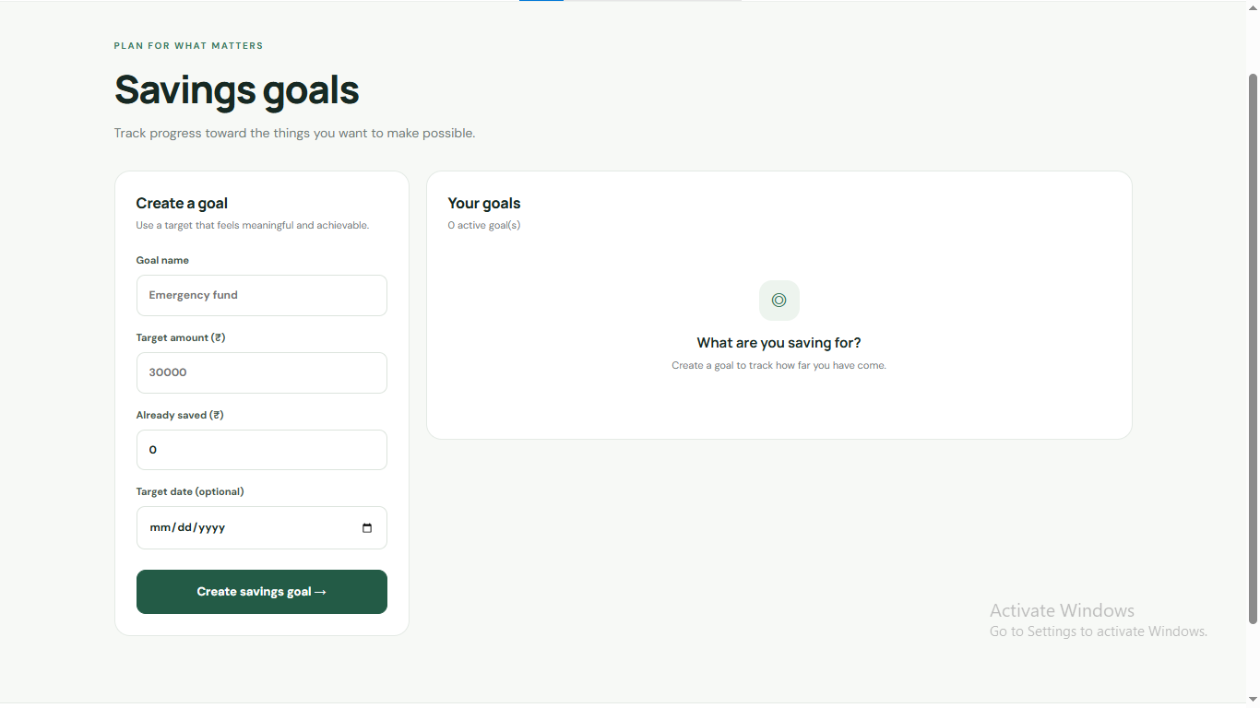
PROTOTYPE DESIGN — KEY SCREENS
The prototype guides users from learning to practical money-management tools.
Home / Landing
Login & Sign-up
Learning Modules
Money Calculators
Transactions
Budgets
Savings Goals
PSE | Digital Literacy & Financial Management

Slide 11
IMPLEMENTATION CHALLENGES
• Making content simple without losing accuracy
• Designing for different skill levels and languages
• Protecting personal and financial information
• Testing usability on mobile screens
• Avoiding the impression of providing personalised financial advice
WHAT WE NEED TO LEARN
• User needs through short interviews
• Common scam patterns from trusted sources
• Accessibility and plain-language design
• How to test learning outcomes reliably
SCOPE FOR IMPROVEMENT
• Add regional languages and audio lessons
• Add offline mode and downloadable guides
• Improve accessibility and screen-reader support
• Add facilitator dashboard and more quizzes
PROTOTYPE TIMELINE (4 WEEKS)
Week 1: user research and requirements
Week 2: wireframes and lesson content
Week 3: build learning and finance modules
Week 4: user testing, fixes and presentation
PSE | Digital Literacy & Financial Management
11

Slide 12
REFERENCES (USE THE LATEST VERSIONS)
• Reserve Bank of India — Financial Education: https://www.rbi.org.in/
• National Centre for Financial Education: https://www.ncfe.org.in/
• Ministry of Electronics and Information Technology: https://www.meity.gov.in/
• CERT-In — Cyber Security Awareness: https://www.cert-in.org.in/
• Digital India: https://www.digitalindia.gov.in/
Before submission, add the exact pages/articles consulted and any local survey results. Use these sources to verify facts and prepare the learning content.
PSE | Digital Literacy & Financial Management
12

